Slide 1
Phases of Database Design
Conceptual design begins with the collection of requirements and results needed from the database (ER Diag.)
Logical schema is a description of the structure of the database (Relational, Network, etc.)
Physical schema is a description of the implementation (programs, tables, dictionaries, catalogs

Slide 2
Overview of Database Design
Requirements Analysis: Understand what data will be stored in the database, and the operations it will be subject to.
Conceptual Design: (ER Model is used at this stage.)
What are the entities and relationships in the enterprise?
What information about these entities and relationships should we store in the database?
What are the integrity constraints or business rules that hold?
A database `schema’ in the ER Model can be represented pictorially (ER diagrams).
Can map an ER diagram into a relational schema.
Logical Design: Convert the conceptual database design into the data model underlying the DBMS chosen for the application.

Slide 3
Overview of Database Design (cont.)
Schema Refinement: (Normalization) Check relational schema for redundancies and anomalies.
Physical Database Design and Tuning: Consider typical workloads and further refinement of the database design (v.g. build indices).
Application and Security Design: Consider aspects of the application beyond data. Methodologies like UML often used for addressing the complete software development cycle.

Slide 4
ER Model Basics
name
ssn
lot
Employees
Entity: Real-world object distinguishable from other objects. An entity is described using a set of attributes.
Entity Set: A collection of entities of the same kind. E.g., all employees.
All entities in an entity set have the same set of attributes.
Each entity set has a key(a set of attributes uniquely identifying an entity).
Each attribute has a domain.

Slide 5
ER Model Basics (Contd.)
name
ssn
lot
since
Employees
name
dname
super-visor
ssn
lot
did
budget
subor-dinate
Works_In
Reports_To
Employees
Departments
Relationship: Association among two or more entities. E.g., Peter works in Pharmacy department.
Relationship Set: Collection of similar relationships.
An n-ary relationship set R relates n entity sets E1 ... En; each relationship in R involves entities e₁ ∈ E1, ..., e_{n} ∈ En
Same entity set could participate in different relationship sets, or in different “roles” in same set.
Relationship sets can also have descriptive attributes (e.g., the since attribute of Works_In). A relationship is uniquely identified by participating entities without reference to descriptive attributes.

Slide 6
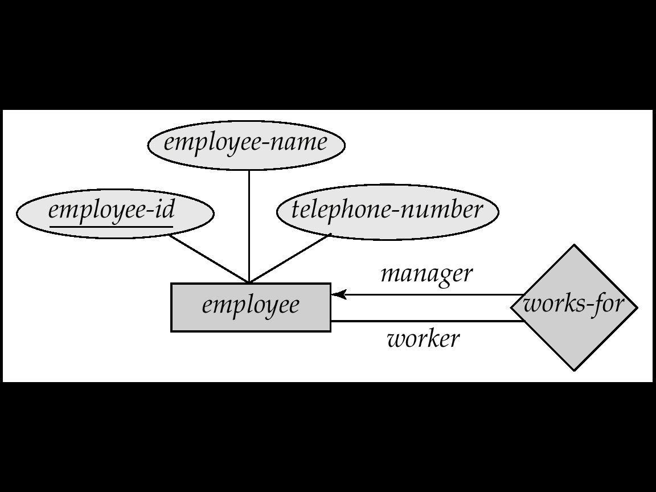
Self Relationship
Sometimes entities in a entity set may relate to other entities in the same set. Thus self relationship
Here employees mange some other employees
The labels “manger” and “worker” are called roles the self relationship

Slide 7
Key Constraints (a.k.a. Cardinality)
since
Consider Works_In (in previous slide): An employee can work in many departments; a dept can have many employees.
In contrast, each dept has at most one manager, according to the key constraint on Manages.
name
dname
ssn
lot
did
budget
Employees
Manages
Departments
1-to-1
1-to Many
Many-to-1
Many-to-Many
Constraints are IMPORTANT because they must be ENFORCED
when IMPLEMENTING the database

Slide 8
Key Constraints (ternary relationships)
name
Location
name
dname
Each employee can work at
most in one department at
a single location
ssn
lot
did
budget
Employees
works_In
Departments
12-233
D10
12-354
D12
12-243
D13
12-299
Rome
London
Paris

Slide 9
Participation Constraints
Does every department have a manager?
If so, this is a participation constraint: the participation of Departments in Manages is said to be total (vs. partial).
Every Department MUST have at least an employee
Every employee MUST work at least in one department
There may exist employees managing no department
since
since
name
name
dname
dname
ssn
did
did
budget
lot
budget
Employees
Manages
Departments
Works_In
since

Slide 10
Weak Entities
A weak entity can be identified uniquely only by considering the primary key of another (owner) entity.
Owner entity set and weak entity set must participate in a one-to-many relationship set (one owner, many weak entities).
Weak entity sets must have total participation in this identifying relationship set.
transac# is a discriminator within a group of transactions in an ATM.
address
atmID
since
transac#
amount
type
ATM
Transactions

Slide 11
ISA (`is a’) Hierarchies
name
ssn
lot
Employees
As in C++, or other PLs, attributes are inherited.
hourly_wages
hours_worked
ISA
If we declare A ISA B, every A entity is also considered to be a B entity.
contractid
Hourly_Emps
Contract_Emps
Overlap constraints: Can Joe be an Hourly_Emps as well as a Contract_Emps entity? if so, specify => Hourly_Emps OVERLAPS Contract_Emps.
Covering constraints: Does every Employees’ entity also have to be an Hourly_Emps or a Contract_Emps entity?. If so, write Hourly_Emps AND Contract_Emps COVER Employees.
Reasons for using ISA:
To add descriptive attributes specific to a subclass.
To identify entities that participate in a relationship.

Slide 12
Aggregation
name
ssn
lot
Employees
Used when we have to model a relationship involving (entity sets and) a relationship set.
Aggregation allows us to treat a relationship set as an entity set for purposes of participation in (other) relationships.
Employees are assigned to monitor SPONSORSHIPS.
Monitors
until
started_on
since
dname
pid
pbudget
did
budget
Projects
Sponsors
Departments
Aggregation vs. ternary relationship:
Monitors and Sponsors are distinct relationships, with descriptive attributes of their own.
Also, can say that each sponsorship
is monitored by at most one employee (which we cannot do with a ternary relationship).

Slide 13
Conceptual Design Using the ER Model
Design choices:
Should a concept be modeled as an entity or an attribute?
Should a concept be modeled as an entity or a relationship?
Identifying relationships: Binary or ternary? Aggregation?
Constraints in the ER Model:
A lot of data semantics can (and should) be captured.
But some constraints cannot be captured in ER diagrams.

Slide 14
Key in a table
A key in a table is a field or group of fields that creates identity, makes relationship with another table and/or make a table more efficient.
Super Key – An attribute or a combination of attribute that is used to identify the records uniquely is known as Super Key. A table can have many Super Keys.
E.g. of Super Key
1 ID
2 ID, Name
3 ID, Address
4 ID, Department_ID
5 ID, Salary
6 Name, Address
7 Name, Address, Department_ID ………… So on as any combination which can identify the records uniquely will be a Super Key. table or be NULL.

Slide 15
(II) Candidate Key – It can be defined as minimal Super Key or irreducible Super Key. In other words an attribute or a combination of attribute that identifies the record uniquely but none of its proper subsets can identify the records uniquely.
E.g. of Candidate Key
1 Code
2 Name, Address
For above table we have only two Candidate Keys (i.e. Irreducible Super Key) used to identify the records from the table uniquely. Code Key can identify the record uniquely and similarly combination of Name and Address can identify the record uniquely, but neither Name nor Address can be used to identify the records uniquely as it might be possible that we have two employees with similar name or two employees from the same house.

Slide 16
Primary Key & Foreign
A Primary key is a key that uniquely identifies a row in each table. It is normally denoted with its first two letters, namely, PK.
A Foreign key is a key borrowed from another related table (that’s why its foreign) in order to make the relationship between two tables. It is normally denoted with its first two letters, namely, FK.

Slide 17
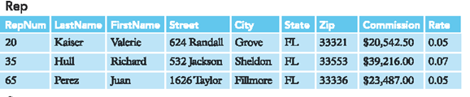
Examples from Premier Database – Primary Key
Repnum uniquely identifies the Rep table
and is the primary key of this table.

Slide 18
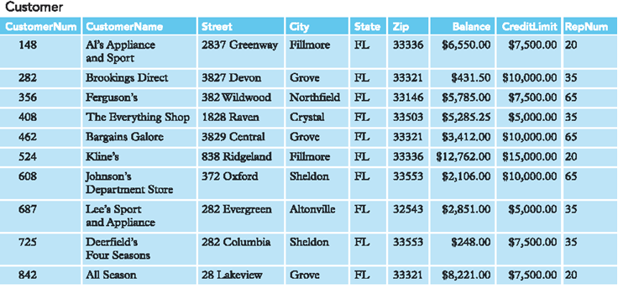
Examples from Premier Database – Primary Key
Customernum uniquely identifies the Customer table
and is the primary key of this table.

Slide 19
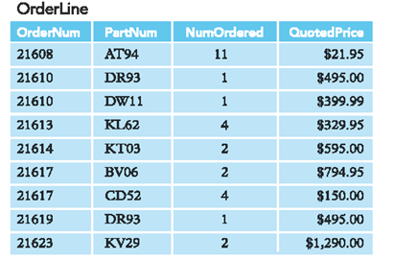
Examples from Premier Database – Primary Key
Ordernum and Partnum makes up the primary key
Of the OrderLine table. This is what is known as a Composite
Primary key, that is, primary key that is made up of more than
one field.

Slide 20
Examples from Premier Database – Foreign Key
Repnum is a Foreign key borrowed from Rep table

Slide 21
Notation example
One Rep could have one or more customer (one to many) using
Primary and foreign key to create the relationship.
Customer
Customernum (PK) Customername Street City State Zip Balance CreditLimit Repnum (FK)
1
Rep
Repnum (PK) Lastname Firstname Street City State Zip Commission Rate
M

Slide 22
Notation example
Always remember the many side has the Foreign key. In this case the many side is on the Customer table and therefore has the foreign key Repnum which is the primary key of Rep table.
Customer
Customernum (PK) Customername Street City State Zip Balance CreditLimit Repnum (FK)
1
Rep
Repnum (PK) Lastname Firstname Street City State Zip Commission Rate
M

Slide 23
Referential Integrity
Referential Integrity means that the Foreign key must match in terms of actual values and data types with the related Primary Key.

Slide 24
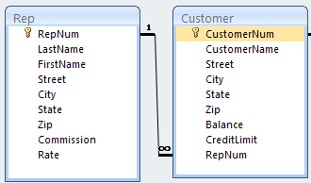
Referential Integrity
Example:
The foreign key RepNum in Customer must match with the primary key RepNum in Rep table.

Slide 25
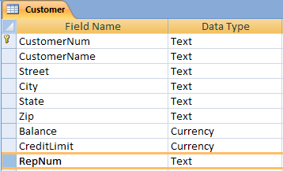
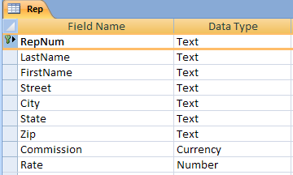
Referential Integrity
In terms of Data Type
Customer RepNum (Foreign Key) has Text Data type and Rep RepNum (Primary Key) has also Text Data type.

Slide 26
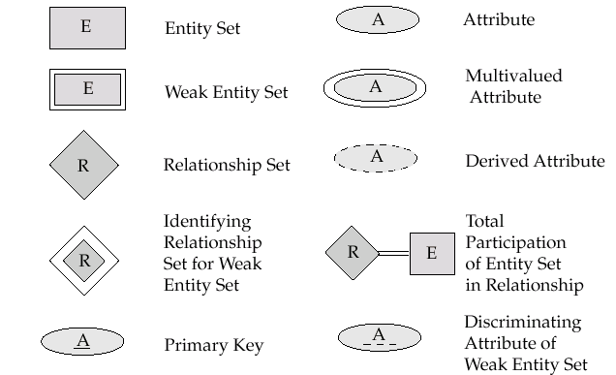
Notations used in ER diagram

Slide 27

Notations used in ER diagram

Slide 28
Translating ER Model to Relational Model

Slide 29
Review - Concepts
Relational Model is made up of tables
A row of table = a relational instance/tuple
A column of table = an attribute
A table = a schema/relation
Cardinality = number of rows
Degree = number of columns

Slide 30
Review - Example
Attribute
tuple/relational instance
Cardinality = 2
SID | Name | Major | GPA
1234 | John | CS | 2.8
5678 | Mary | EE | 3.6
4 Degree
A Schema / Relation

Slide 31
From ER Model to Relational Model
So… how do we convert an ER diagram into a table?? Simple!!
Basic Ideas:
Build a table for each entity set
Build a table for each relationship set if necessary
Make a column in the table for each attribute in the entity set
Primary Key
Contraints

Slide 32
Example – Strong Entity Set
SID
Name
SSN
Name
Student
Advisor
Professor
Major
Dept
GPA
SID | Name | Major | GPA
1234 | John | CS | 2.8
5678 | Mary | EE | 3.6
SSN | Name | Dept
9999 | Smith | Math
8888 | Lee | CS

Slide 33
Representation of Weak Entity Set
Weak Entity Set Cannot exists alone
To build a table/schema for weak entity set
Construct a table with one column for each attribute in the weak entity set
Remember to include discriminator
Augment one extra column on the right side of the table, put in there the primary key of the Strong Entity Set (the entity set that the weak entity set is depending on)
Primary Key of the weak entity set = Discriminator + foreign key

Slide 34
Example – Weak Entity Set
Age
SID
Name
Name
Student
owns
Children
Major
GPA
Age | Name | Parent_SID
10 | Bart | 1234
8 | Lisa | 5678
* Primary key of Children is Parent_SID + Name

Slide 35
Representation of Relationship Set
Unary/Binary Relationship set
Depends on the cardinality and participation of the relationship
Two possible approaches
N-ary (multiple) Relationship set
Primary Key Issue
Identifying Relationship
No relational model representation necessary

Slide 36
Representing Relationship Set Unary/Binary Relationship
For one-to-one relationship w/out total participation
Build a table with two columns, one column for each participating entity set’s primary key. Add successive columns, one for each descriptive attributes of the relationship set (if any).
For one-to-one relationship with one entity set having total participation
Augment one extra column on the right side of the table of the entity set with total participation, put in there the primary key of the entity set without complete participation as per to the relationship.

Slide 37
Example – One-to-One Relationship Set
Degree
SID
Name
ID Code
Student
study
Major
Major
GPA
SID | Maj_ID Co | S_Degree
9999 | 07 | 1234
8888 | 05 | 5678
* Primary key can be either SID or Maj_ID_Co

Slide 38
Example – One-to-One Relationship Set
Condition
SID
Name
1:1 Relationship
S/N #
Student
Have
Laptop
Major
GPA
Brand
SID | Name | Major | GPA | LP_S/N | Hav_Cond
9999 | Bart | Economy | -4.0 | 123-456 | Own
8888 | Lisa | Physics | 4.0 | 567-890 | Loan
* Primary key can be either SID or LP_S/N

Slide 39
Representing Relationship Set Unary/Binary Relationship
For one-to-many relationship w/out total participation
Same thing as one-to-one
For one-to-many/many-to-one relationship with one entity set having total participation on “many” side
Augment one extra column on the right side of the table of the entity set on the “many” side, put in there the primary key of the entity set on the “one” side as per to the relationship.

Slide 40
Example – Many-to-One Relationship Set
Semester
SID
Name
N:1 Relationship
SSN
Student
Advisor
Professor
Major
GPA
Dept
Name
SID | Name | Major | GPA | Pro_SSN | Ad_Sem
9999 | Bart | Economy | -4.0 | 123-456 | Fall 2006
8888 | Lisa | Physics | 4.0 | 567-890 | Fall 2005
* Primary key of this table is SID

Slide 41
Representing Relationship Set Unary/Binary Relationship
For many-to-many relationship
Same thing as one-to-one relationship without total participation.
Primary key of this new schema is the union of the foreign keys of both entity sets.
No augmentation approach possible…

Slide 42
Representing Relationship Set N-ary Relationship
Intuitively Simple
Build a new table with as many columns as there are attributes for the union of the primary keys of all participating entity sets.
Augment additional columns for descriptive attributes of the relationship set (if necessary)
The primary key of this table is the union of all primary keys of entity sets that are on “many” side
That is it, we are done.

Slide 43
Example – N-ary Relationship Set
P-Key1
D-Attribute
A-Key
E-Set 1
P-Key2
A relationship
Another Set
E-Set 2
P-Key3
E-Set 3
P-Key1 | P-Key2 | P-Key3 | A-Key | D-Attribute
9999 | 8888 | 7777 | 6666 | Yes
1234 | 5678 | 9012 | 3456 | No
* Primary key of this table is P-Key1 + P-Key2 + P-Key3

Slide 44
Representing Relationship Set Identifying Relationship
This is what you have to know
You DON’T have to build a table/schema for the identifying relationship set once you have built a table/schema for the corresponding weak entity set
Reason:
A special case of one-to-many with total participation
Reduce Redundancy

Slide 45
Representing Composite Attribute
Relational Model Indivisibility Rule Applies
One column for each component attribute
NO column for the composite attribute itself
SSN
Name
SSN | Name | Street | City
9999 | Dr. Smith | 50 1st St. | Fake City
8888 | Dr. Lee | 1 B St. | San Jose
Professor
Address
Street
City

Slide 46
Representing Multivalue Attribute
For each multivalue attribute in an entity set/relationship set
Build a new relation schema with two columns
One column for the primary keys of the entity set/relationship set that has the multivalue attribute
Another column for the multivalue attributes. Each cell of this column holds only one value. So each value is represented as an unique tuple
Primary key for this schema is the union of all attributes

Slide 47
Example – Multivalue attribute
SID
Name
The primary key for this table is Student_SID + Children, the union of all attributes
Children
Student
Major
GPA
Stud_SID | Children
1234 | Johnson
1234 | Mary
5678 | Bart
5678 | Lisa
5678 | Maggie
SID | Name | Major | GPA
1234 | John | CS | 2.8
5678 | Homer | EE | 3.6

Slide 48
Representing Class Hierarchy
Two general approaches depending on disjointness and completeness
For non-disjoint and/or non-complete class hierarchy:
create a table for each super class entity set according to normal entity set translation method.
Create a table for each subclass entity set with a column for each of the attributes of that entity set plus one for each attributes of the primary key of the super class entity set
This primary key from super class entity set is also used as the primary key for this new table

Slide 49
Example
SSN
Name
Person
SID
Status
Gender
ISA
Student
Major
GPA
SSN | Name | Gender
1234 | Homer | Male
5678 | Marge | Female
SSN | SID | Status | Major | GPA
1234 | 9999 | Full | CS | 2.8
5678 | 8888 | Part | EE | 3.6

Slide 50
Representing Class Hierarchy
Two general approaches depending on disjointness and completeness
For disjoint AND complete mapping class hierarchy:
DO NOT create a table for the super class entity set
Create a table for each subclass entity set include all attributes of that subclass entity set and attributes of the superclass entity set
Simple and Intuitive enough, need example?

Slide 51
Example
SSN
Name
No table created for superclass entity set
SJSU people
ISA
SID
Student
Faculty
Disjoint and Complete mapping
Major
GPA
Dept
SSN | Name | SID | Major | GPA
1234 | John | 9999 | CS | 2.8
5678 | Mary | 8888 | EE | 3.6
SSN | Name | Dept
1234 | Homer | C.S.
5678 | Marge | Math

Slide 52
Representing Aggregation
Name
SSN
Name
Student
Advisor
Professor
Dept
SID
Name
member
Primary Key of Advisor
Dept
SID | Code
1234 | 04
5678 | 08
Code
Primary key of Dept

Slide 53
Query Processing

Slide 54
Basic Steps in Query Processing
1. Parsing and translation
2. Optimization
3. Evaluation

Slide 55
Basic Steps in Query Processing (Cont.)
Parsing and translation
translate the query into its internal form. This is then translated into relational algebra.
Parser checks syntax, verifies relations
Evaluation
The query-execution engine takes a query-evaluation plan, executes that plan, and returns the answers to the query.

Slide 56
Basic Steps in Query Processing : Optimization
A relational algebra expression may have many equivalent expressions
E.g., σ_{salary<75000}(∏_{salary}(instructor)) is equivalent to ∏_{salary}(σ_{salary<75000}(instructor))
Each relational algebra operation can be evaluated using one of several different algorithms
Correspondingly, a relational-algebra expression can be evaluated in many ways.
Annotated expression specifying detailed evaluation strategy is called an evaluation-plan.
E.g., can use an index on salary to find instructors with salary < 75000,
or can perform complete relation scan and discard instructors with salary ≥ 75000

Slide 57
Relational Algebra
Fundamentals

Slide 58
What is Relational Algebra?
It is a language in which we can ask questions (query) of a database.
Basic premise is that tables are sets (mathematical) and so our query language should manipulate sets with ease.
Select
Project
Cartesian product
Union
Set Difference
Rename
Notes:
58

Slide 59
Supplier-Part Example
Notes:
59

Slide 60
SELECTION:
Selection returns a subset of the rows of a single table.
Syntax:
select <table_name> where <condition> /* the <condition> must involve only
columns from the indicated table */
alternatively
σ _{<condition>} (table_name)
Find all suppliers from Boston.
Select Supplier where Location = ‘Bos’ σ _{Location = ‘Bos’} (Supplier)
Notes:
60

Slide 61
SELECTION Exercise:
Find the Cardholders from Modena.
Observations:
There is only one input table.
Both Cardholder and the answer table have the same schema (list of columns)
Every row in the answer has the value ‘Modena’ in the b_addr column.
select Cardholder where b_addr = ‘Modena’
alternatively
σ _{b_addr = ‘Modena’} (Cardholder)
Notes:
61

Slide 62
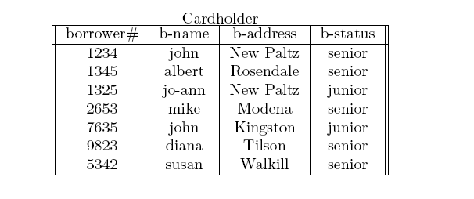

SELECTION:
same schema
Answer
All rows in the answer have the value ‘Modena’ in the b_addr column
Notes:
62

Slide 63
PROJECTION:
Projection returns a subset of the columns of a single table.
Syntax:
project <table_name> over <list of columns> /* the columns in <list of columns> must
come from the indicated table */
alternatively
π _{<list of columns>} (table_name)
Find all supplier names
Project Supplier over Sname π _{Sname} (Supplier)
Notes:
63

Slide 64
PROJECTION Exercise:
Find the addresses of all Cardholders.
Observations:
There is only one input table.
The schema of the answer table is the list of columns
If there are many Cardholders living at the same address these are not duplicated in the answer table.
project Cardholder over b_addr
alternatively
π _{b_addr} (Cardholder)
Notes:
64

Slide 65
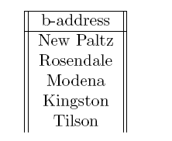
PROJECTION:
schema of answer table is the same as the list of columns in the query
Answer
Duplicate ‘New Paltz’ values in the Cardholder table are dropped from the Answer table
Notes:
65

Slide 66
CARTESIAN PRODUCT:
The Cartesian product of two sets is a set of pairs of elements (tuples), one from each set.
If the original sets are already sets of tuples then the tuples in the Cartesian product are all that bigger.
Syntax:
As we have seen, Cartesian products are usually unrelated to a real-world thing. They normally contain some noise tuples.
However they may be useful as a first step.
<table_name> x <table_name>
Notes:
66

Slide 67
CARTESIAN PRODUCT:
5 rows
4 rows
20 rows
noise: 13 rows in total
info: 7 rows in total
Notes:
67

Slide 68
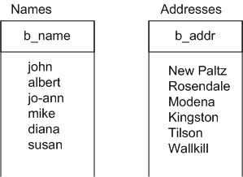
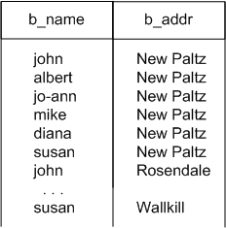
CARTESIAN PRODUCT Exercise:
Names = Project Cardholder over b_name Addresses = Project Cardholder over b_addr Names x Addresses
Names x Addresses
.
.
.
noise
Names x Addresses
Info = project cardholder over b_name, b_addr
How many rows?
36
Notes:
68
Experiential, eval info

Slide 69
UNION:
Treat two tables as sets and perform a set union
Syntax:
Observations:
This operation is impossible unless both tables involved have the same schemas. Why?
Because rows from both tables must fit into a single answer table; hence they must “look alike”.
Because some rows might already belong to both tables
Table1 UNION Table2 alternatively Table1 Table2
∩
Notes:
69
Eval info, conceptualize

Slide 70
UNION Example:
Part1Suppliers = project (select Supplies where Pno = ‘p1’) over Sno
Part2Suppliers = project (select Supplies where Pno = ‘p2’) over Sno
Part1Suppliers UNION Part2Suppliers
alternatively
Part1Suppliers = π_{Sno}(σ_{Pno = ‘p1’} (Supplies) )
Part2Suppliers = π_{Sno}(σ_{Pno = ‘p2’} (Supplies) )
Answer = Part1Suppliers Part2Suppliers
∩
Notes:
70

Slide 71
UNION Exercise:
Find the borrower numbers of all borrowers who have either borrowed or reserved a book (any book).
Reservers = project Reserves over borrowerid
Borrowers = project Borrows over borrowerid
Answer = Borrowers union Reservers
alternatively
Reservers = π_{borrowerid} (Reserves)
Borrowers = π_{borrowerid}(Borrows) Answer = Borrowers Reservers
∩
not duplicated
Notes:
71

Slide 72
INTERSECTION:
Treat two tables as sets and perform a set intersection
Syntax:
Observations:
This operation is impossible unless both tables involved have the same schemas. Why?
Because rows from both tables must fit into a single answer table; hence they must “look alike”.
Table1 INTERSECTION Table2 alternatively Table1 Table2
∩
Notes:
72
Eval info, conceptualize

Slide 73
INTERSECTION Example:
Part1Suppliers = project (select Supplies where Pno = ‘p1’) over Sno
Part2Suppliers = project (select Supplies where Pno = ‘p2’) over Sno
Part1Suppliers INTERSECT Part2Suppliers
alternatively
Part1Suppliers = π_{Sno}(σ_{Pno = ‘p1’} (Supplies) )
Part2Suppliers = π_{Sno}(_{σPno = ‘p2’} (Supplies) )
Answer = Part1Suppliers Part2Suppliers
∩
Notes:
73

Slide 74
INTERSECTION Exercise:
Find the borrower numbers of all borrowers who have borrowed and reserved a book.
Reservers = project Reserves over borrowerid
Borrowers = project Borrows over borrowerid
Answer = Borrowers intersect Reservers
alternatively
Reservers = π_{borrowerid} (Reserves)
Borrowers = π_{borrowerid}(Borrows) Answer = Borrowers Reservers
∩
Notes:
74

Slide 75
SET DIFFERENCE:
Treat two tables as sets and perform a set intersection
Syntax:
Observations:
This operation is impossible unless both tables involved have the same schemas. Why?
Because it only makes sense to calculate the set difference if the two sets have elements in common.
Table1 MINUS Table2 alternatively Table1 \ Table2
Notes:
75
Eval info, conceptualize

Slide 76
SET DIFFERENCE Example:
Part1Suppliers = project (select Supplies where Pno = ‘p1’) over Sno
Part2Suppliers = project (select Supplies where Pno = ‘p2’) over Sno
Part1Suppliers MINUS Part2Suppliers
alternatively
Part1Suppliers = π_{Sno}(σ_{Pno = ‘p1’} (Supplies) )
Part2Suppliers = π_{Sno}(σ_{Pno = ‘p2’} (Supplies) )
Answer = Part1Suppliers \ Part2Suppliers
Notes:
76

Slide 77
SET DIFFERENCE Exercise:
Find the borrower numbers of all borrowers who have borrowed something and reserved nothing.
Reservers = project Reserves over borrowerid
Borrowers = project Borrows over borrowerid
Answer = Borrowers minus Reservers
alternatively
Reservers = π_{borrowerid} (Reserves)
Borrowers = π_{borrowerid}(Borrows) Answer = Borrowers \ Reservers
Notes:
77

